Slide 1
Syntax Analyzer or Parsers

Slide 2
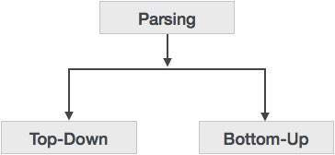
Syntax Analyzers or Parsers
Process of deriving string from a given grammar.
Syntax analyzers follow production rules defined by means of context-free grammar. The way the production rules are implemented (derivation) divides parsing into two types : top-down parsing and bottom-up parsing.

Slide 3
Parsers
Top Down Parsers (TDP)
Bottom Up Parsers (BUP) (shift-reduce)
TDP with full Backtracking
TDP without Backtracking (predictive)
Operator Precedence Parser
Left to Right (LR) Parser
Brute-force method
Recursive Descent
Non-Recursive Descent (LL(1))
LR(0)
SLR(0)
LALR(1)
CLR(1)
L - Left to right
L – Left most derivation
(1) - look ahead 1

Slide 4
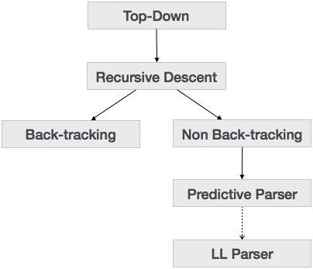
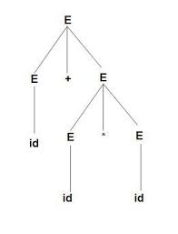
Top-down Parsing
top-down parsing technique parses the input,
and starts constructing a parse tree from the root node
gradually moving down to the leaf nodes.
E -> E + E
E -> E * E
E -> id
L - Left to right
L – Left most derivation
(1) - look ahead 1

Slide 5
Recursive Descent Parsing
Recursive descent is a top-down parsing technique that constructs the parse tree from the top and the input is read from left to right.
This parsing technique recursively parses the input to make a parse tree, which may or may not require back-tracking.
But the grammar associated with it (if not left factored) cannot avoid back-tracking. A form of recursive-descent parsing that does not require any back-tracking is known as predictive parsing.
This parsing technique is regarded recursive as it uses context-free grammar which is recursive in nature.

Slide 6
Back-tracking
Top- down parsers start from the root node (start symbol) and match the input string against the production rules to replace them (if matched). To understand this, take the following example of CFG:
S → rXd | rZd
X → oa | ea
Z → ai

Slide 7
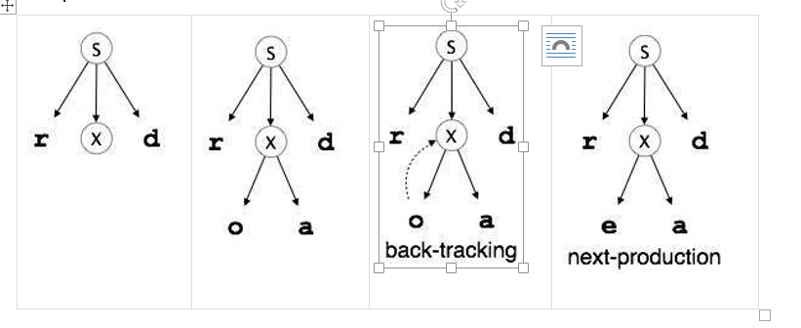

Slide 8
Predictive Parser
Predictive parser is a recursive descent parser, which has the capability to predict which production is to be used to replace the input string. The predictive parser does not suffer from backtracking.
To accomplish its tasks, the predictive parser uses a look-ahead pointer, which points to the next input symbols. To make the parser back-tracking free, the predictive parser puts some constraints on the grammar and accepts only a class of grammar known as LL(k) grammar.

Slide 9
Bottom-up Parser
Bottom-up parsing starts from the leaf nodes of a tree and works in upward direction till it reaches the root node. Here, we start from a sentence and then apply production rules in reverse manner in order to reach the start symbol. The image given below depicts the bottom-up parsers available.

Slide 10
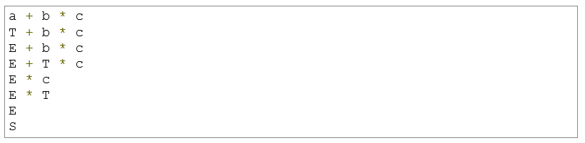
Production rules:
S → E
E → E + T
E → E * T
E → T
T → id

Slide 11
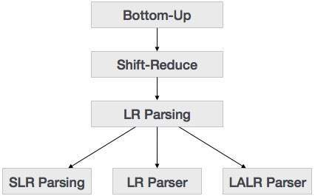
Bottom-up Parser
LR (0) -> Left to Right and Right most derivation

Slide 12
Shift-Reduce Parsing
Shift-reduce parsing uses two unique steps for bottom-up parsing. These steps are known as shift-step and reduce-step.
Shift step: The shift step refers to the advancement of the input pointer to the next input symbol, which is called the shifted symbol. This symbol is pushed onto the stack. The shifted symbol is treated as a single node of the parse tree.
Reduce step : When the parser finds a complete grammar rule (RHS) and replaces it to (LHS), it is known as reduce-step. This occurs when the top of the stack contains a handle. To reduce, a POP function is performed on the stack which pops off the handle and replaces it with LHS non-terminal symbol.

Slide 13
LR Parser
The LR parser is a non-recursive, shift-reduce, bottom-up parser. It uses a wide class of context-free grammar which makes it the most efficient syntax analysis technique.
LR parsers are also known as LR(k) parsers, where L stands for left-to-right scanning of the input stream; R stands for the construction of right-most derivation in reverse, and k denotes the number of lookahead symbols to make decisions.

Slide 14
LR Parser
There are three widely used algorithms available for constructing an LR parser:
SLR(1) – Simple LR Parser:
Works on smallest class of grammar
Few number of states, hence very small table
Simple and fast construction
LR(1) – LR Parser:
Works on complete set of LR(1) Grammar
Generates large table and large number of states
Slow construction
LALR(1) – Look-Ahead LR Parser:
Works on intermediate size of grammar
Number of states are same as in SLR(1)

Slide 15
LL vs. LR
LL | LR
Does a leftmost derivation. | Does a rightmost derivation in reverse.
Starts with the root nonterminal on the stack. | Ends with the root nonterminal on the stack.
Builds the parse tree top-down. | Builds the parse tree bottom-up.
Expands the non-terminals. | Reduces the non-terminals.
Pre-order traversal of the parse tree. | Post-order traversal of the parse tree.

